Slide 1
DBMS LAB (CSL333) PROJECT
EATWISE RESTAURANT
MANAGEMENT SYSTEM
Aravind A Kamath (CEC23CS041)
Arjun Manoj (CEC23CS043)
Anandhakrishnan S (CEC23CS033)
Aravind Sajeev (CEC23CS042)
Computer Science & Engineering (CSE)
Semester 5 (S5)
College of Engineering Cherthala

Slide 2
INDEX
1. Introduction
2. Implementation
3. Code
4. Results
5. Conclusion

Slide 3
INTRODUCTION
EatWise is a small restaurant management application to demonstrate relational database design, CRUD operations, and use of triggers to maintain derived/calculated columns
Objective: to simplify the process of restaurant management (order/suborder/review/menu/customer handling) and improve its efficiency
Tools and technologies used => ReactJS (HTML, CSS, JavaScript, JSX), ExpressJS (NodeJS), MySQL
Purpose/motivation: to alleviate hassles like mixing up of orders, incorrect cash calculations, outdated menu items and other such issues in restaurants

Slide 4
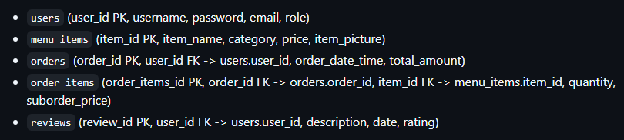
IMPLEMENTATION
A simple client-server restaurant management app: ReactJS frontend communicating with an ExpressJS backend using axios/CORS to manage menu, orders, users, reviews with CRUD flows and role-based homepages
MODULES
Frontend -> App, Homepage, Hero, Login, Review, Credits, AdminLanding, CustomerLanding
Backend -> index.js (single backend file)
User roles – Customer and Admin

Slide 5
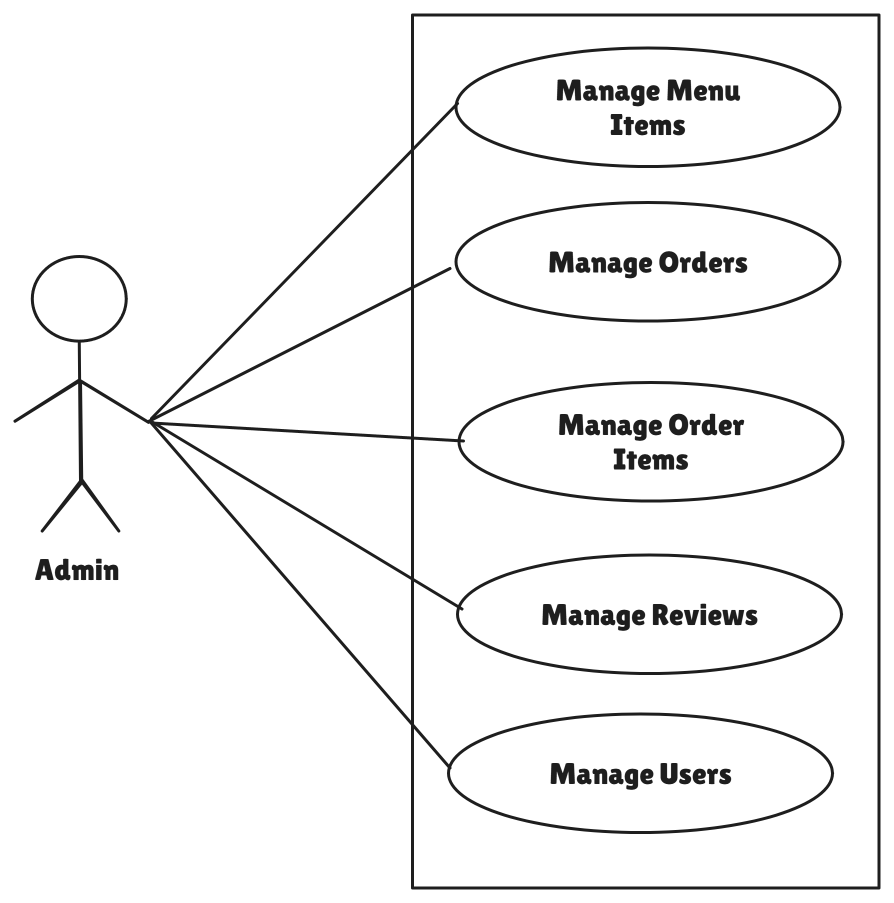
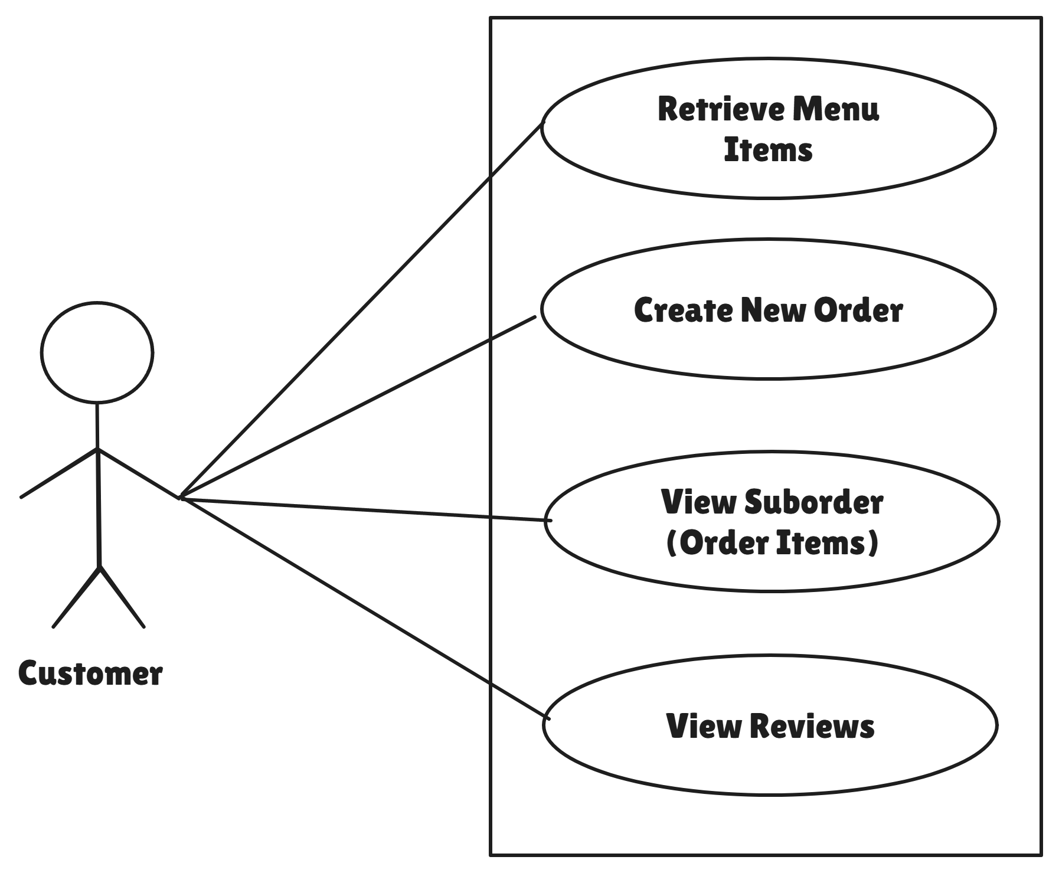
USE CASE DIAGRAM
Customer => view menu_items, create suborders
Admin => manage all 5 tables with create/retrieve/update/delete (CRUD)

Slide 6
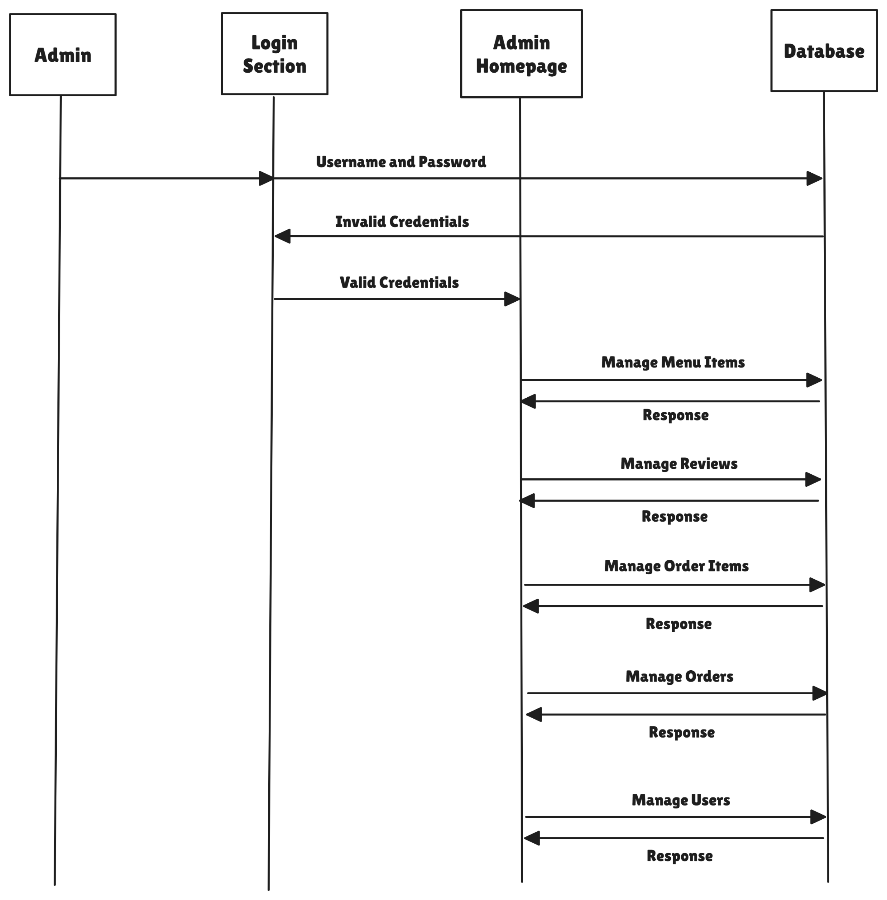
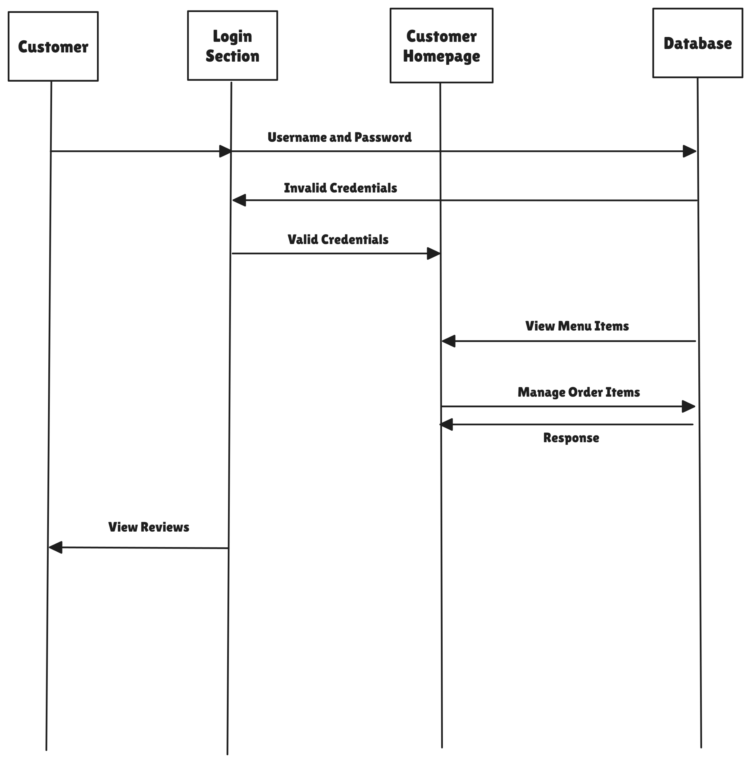
SEQUENCE DIAGRAM
Customer => view menu_items, create suborders
Admin => manage all 5 tables with create/retrieve/update/delete (CRUD)

Slide 7
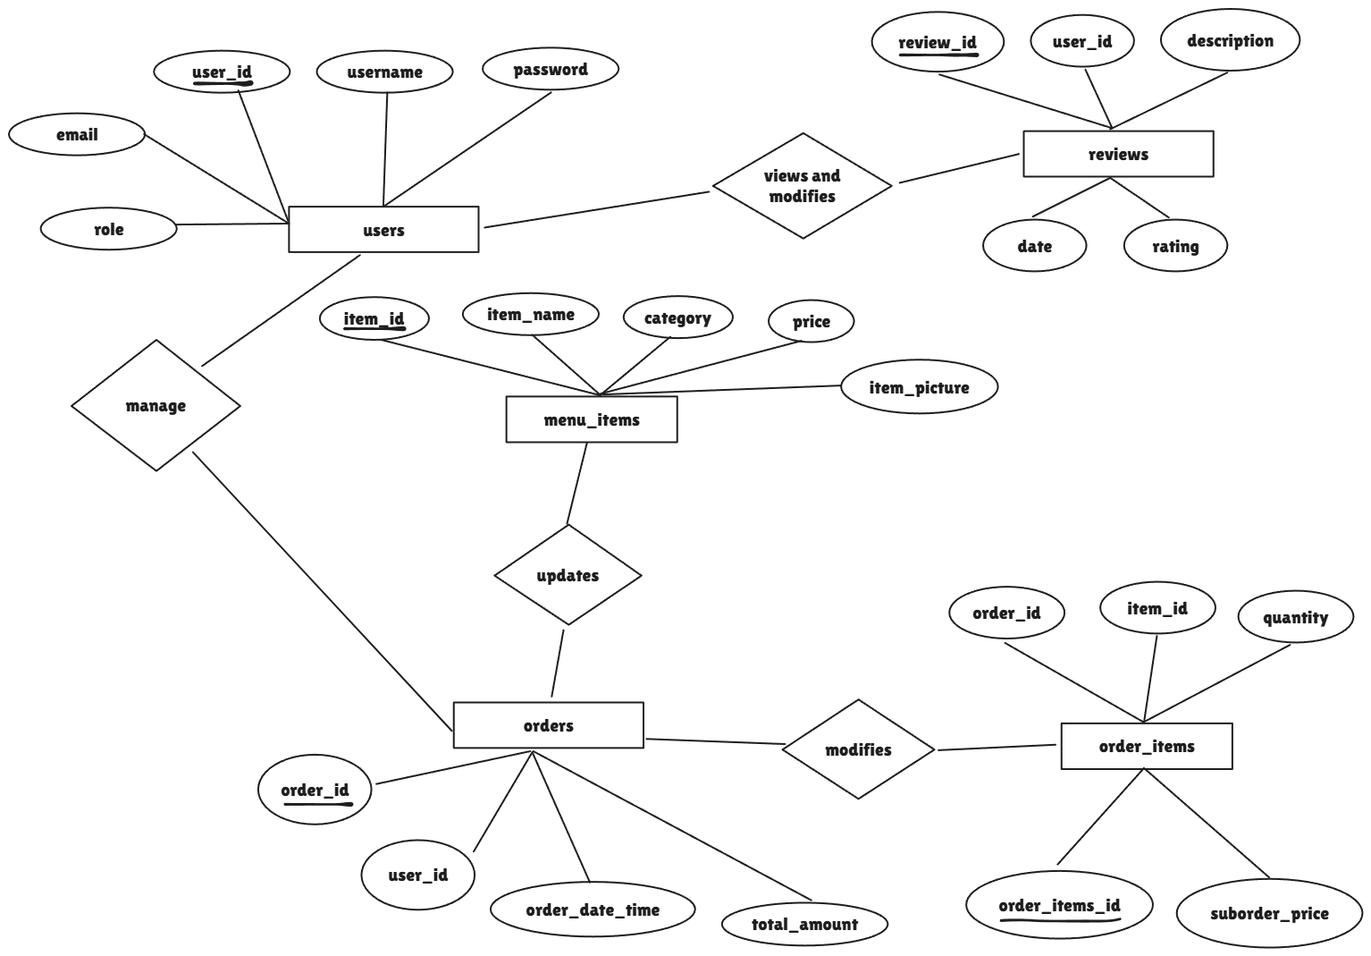
ER DIAGRAM

Slide 8
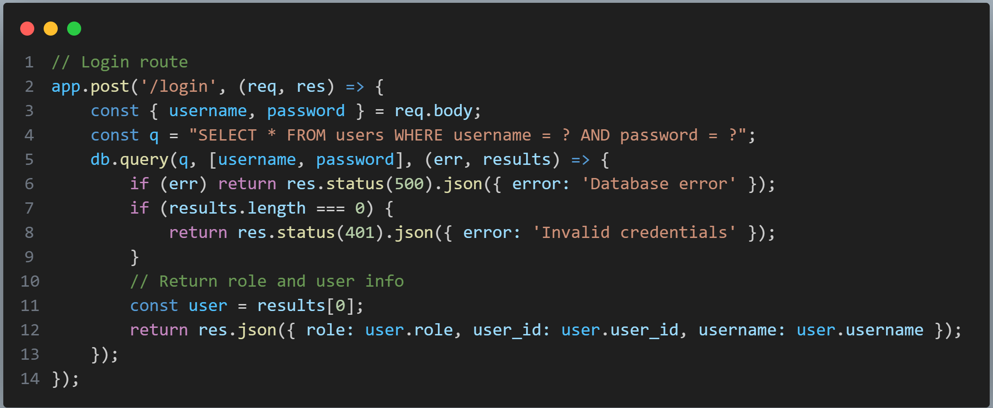
CODE
index.js (backend)

Slide 9
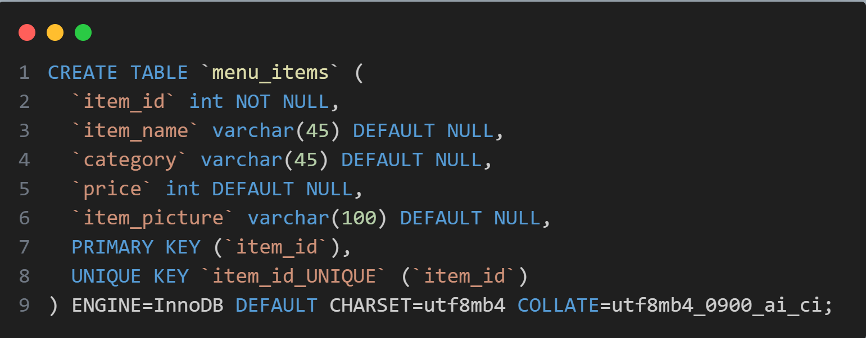
CODE
index.js (backend)
Creation of table menu_items

Slide 10
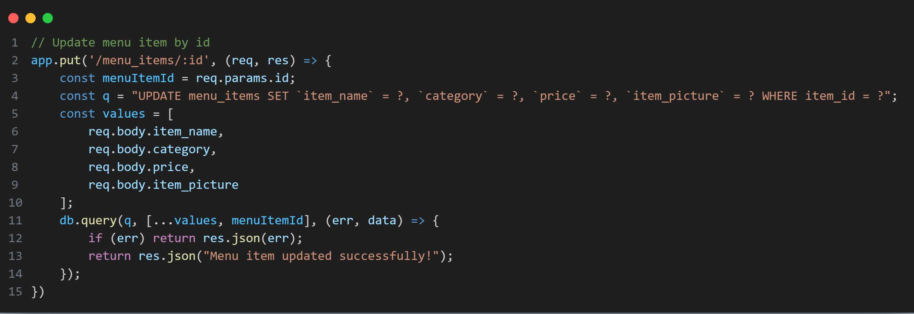
CODE
index.js (backend)
Updation of menu_items

Slide 11
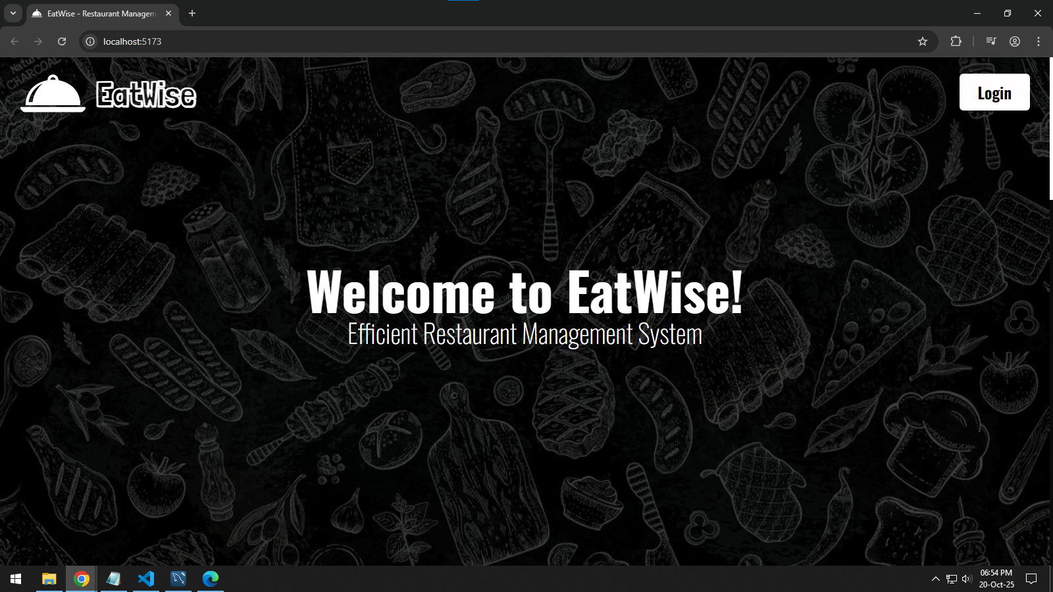
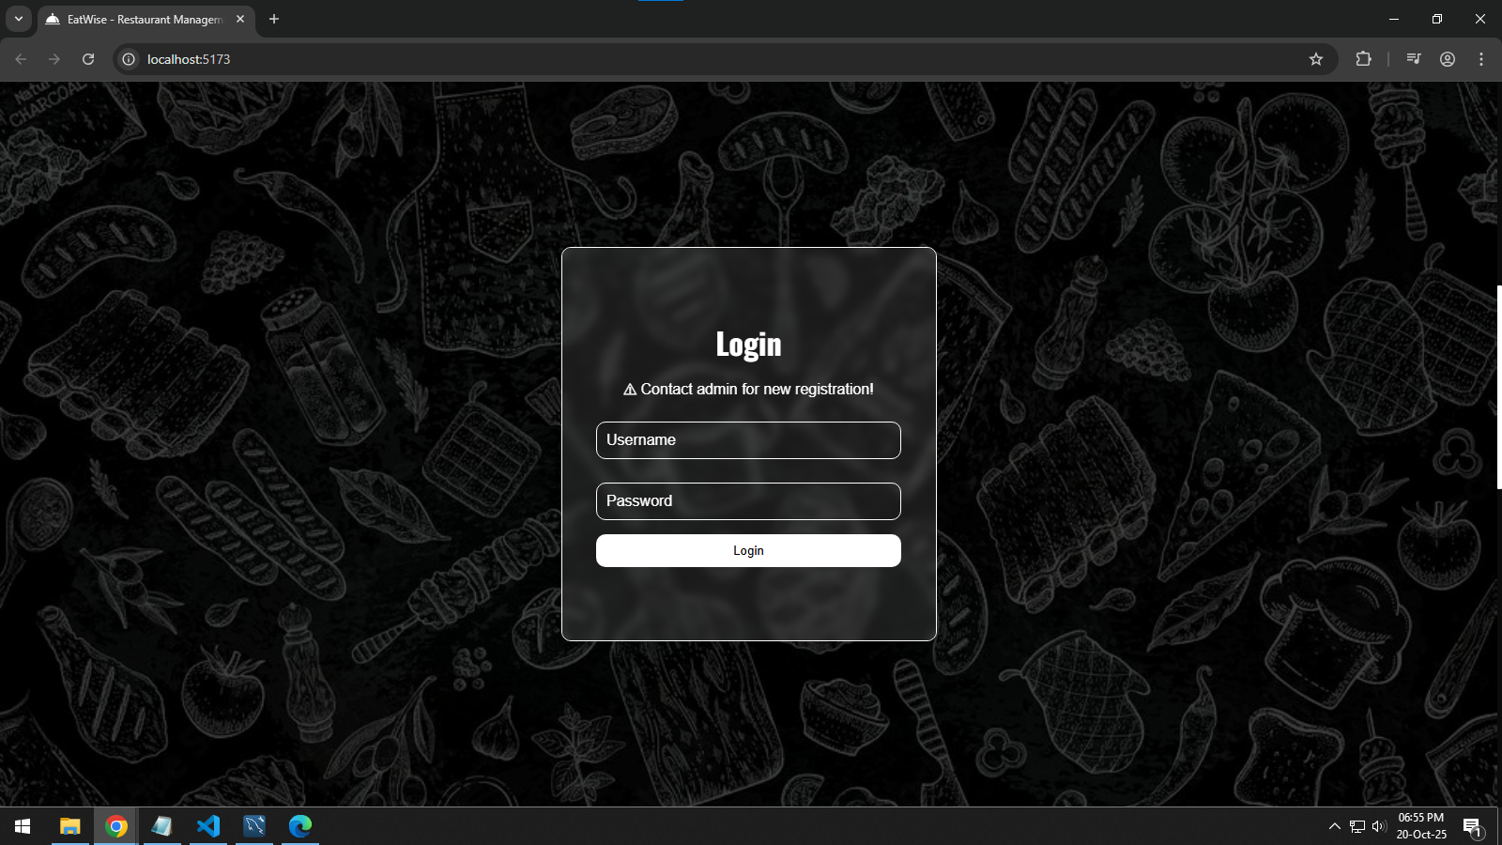
RESULTS
Homepage – simple layout with CSS flexbox and relative/absolute positioning
Login section with glassmorphism UI design with simple inputs and button

Slide 12
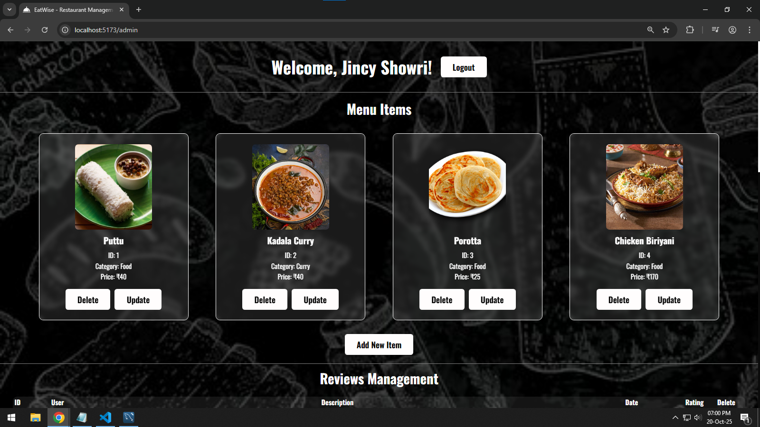
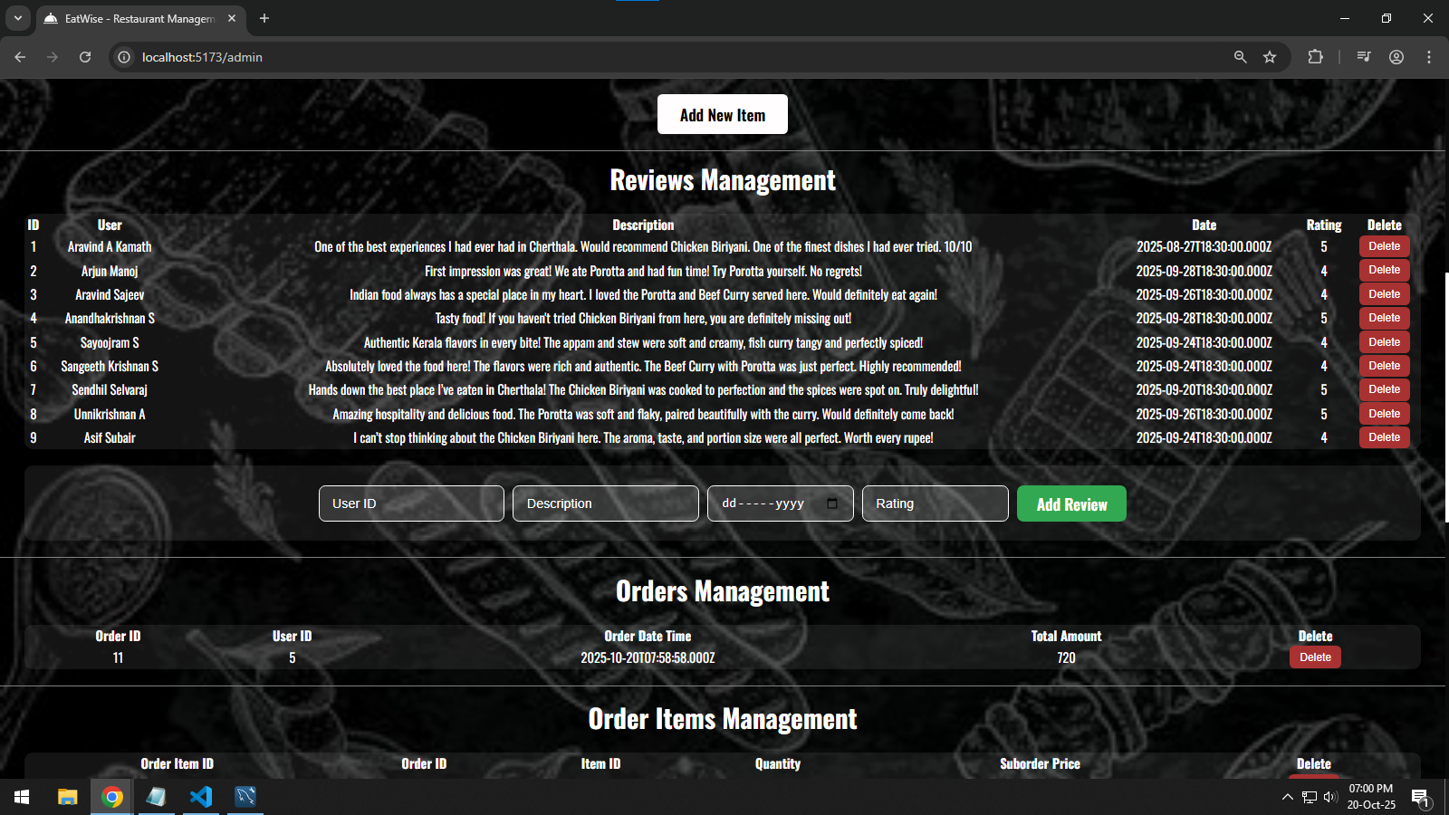
ADMIN HOMEPAGE
Ability to modify all 5 tables’ data (menu_items section shown in screenshot)
Ability to manage different tables including reviews, orders etc…

Slide 13
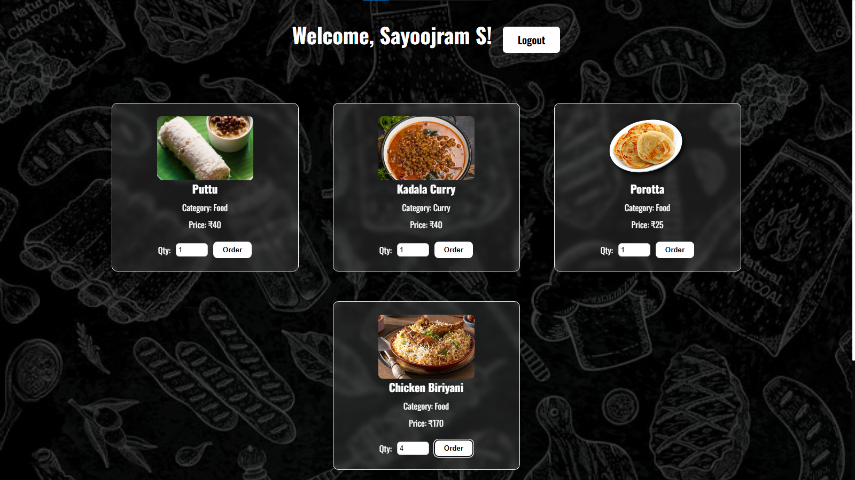
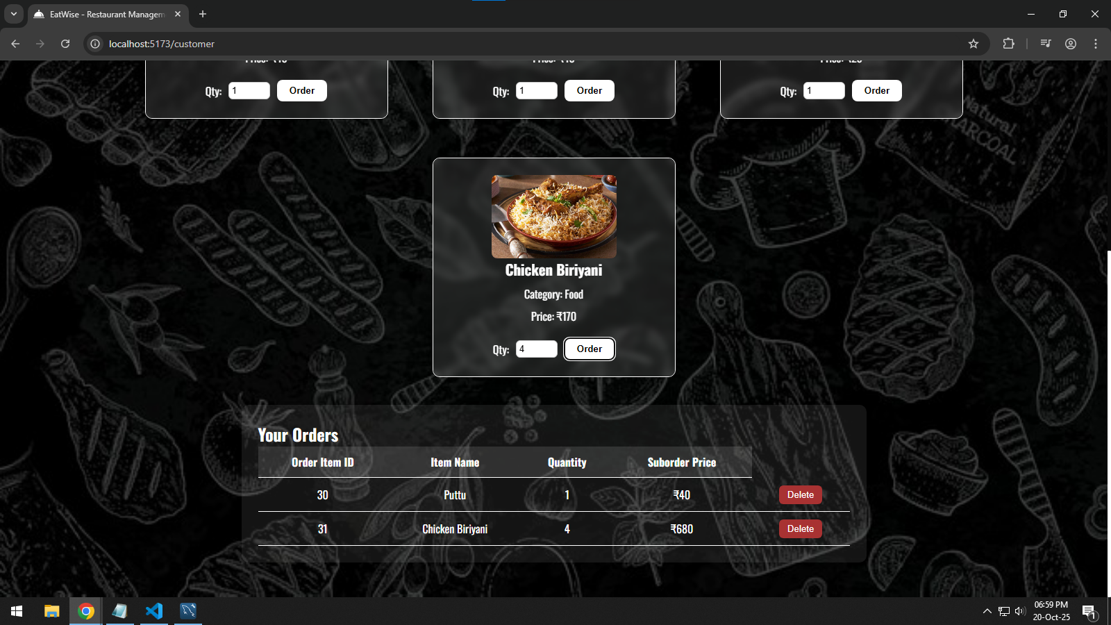
CUSTOMER HOMEPAGE
Ability to view menu_items, select quantity and order
Ability to view and delete suborders

Slide 14
CONCLUSION
A basic but diversely feature-rich web app with vast technologies used for management of 5 tables with data consistency and objective to improve customer/admin experience in restaurant management system
Technologies learned – ReactJS, React Router, React DOM, NodeJS, ExpressJS, MySQL, CORS, Nodemon, SQL Triggers
Possible improvements – adding proper authentication with security, adding more options for table modifications

